Slide 1
PROJECT TITLE
CAPSTONE PROJECT
Presented By:
Jaison Rathinaraj.J
9513- Jayaraj Annapackiam CSI College Of Engineering,
B.E Mechanical Engineering.

Slide 2
OUTLINE
Problem Statement
Proposed System/Solution
System Development Approach
Algorithm & Deployment
Result
Conclusion
Future Scope
References

Slide 3
Problem Statement
Problem Statement : Analyze the current trends, challenges, and opportunities in the online food industry to identify key insights that can inform strategic decision-making for businesses operating in this sector.
Trends Analysis: Investigate the latest trends shaping the online food industry, including shifts in consumer preferences, emerging technologies market consolidation, and regulatory changes. Identify how these trends are impacting different segments of the industry, such as food delivery platforms, cloud kitchens, and traditional restaurants with online ordering capabilities.
Competitive Landscape: Conduct a competitive analysis to understand the strengths, weaknesses, opportunities, and threats faced by major players in the online food space. Evaluate their business models, pricing strategies, customer acquisition and retention tactics, delivery infrastructure, and partnerships with restaurants.
Customer Insights: Gather and analyze customer data to gain insights into consumer behavior, preferences, and satisfaction levels with online food services
Operational Challenges: Identify common operational challenges faced by online food businesses, such as inventory management, delivery logistics, quality control, food safety compliance, and workforce management.
Regulatory and Legal Considerations: Assess the regulatory landscape governing the online food industry, including food safety standards, labor regulations, tax implications, and data privacy laws.

Slide 4
Proposed Solution
Optimized Delivery Logistics:
Implement route optimization algorithms to minimize delivery times and costs.
Utilize real-time tracking systems for orders and delivery vehicles.
Enhanced Customer Experience:
Offer multiple payment options, including digital wallets and cash on delivery.
Implement a user-friendly and intuitive mobile app and website for easy ordering.
Quality Assurance:
Implement quality control measures at every stage of food preparation and delivery.
Conduct regular inspections of partner restaurants and ensure compliance with food safety standards.
Inventory Management:
Adopt inventory management software to track stock levels and avoid stockouts.
Utilize demand forecasting techniques to optimize inventory replenishment and reduce wastage.
Marketing and Promotions:
Launch targeted marketing campaigns to attract new customers and retain existing ones.
Offer discounts, promotions, and loyalty programs to incentivize repeat orders.
Collaborate with influencers and bloggers for endorsement and brand visibility.
Regulatory Compliance:
Stay updated with food safety regulations and ensure compliance with local laws.
Train staff and partners on hygiene practices, food handling, and safety protocols.
Maintain transparency in ingredient sourcing, nutritional information, and allergen disclosures.

Slide 5
System Approach
Market Research and Analysis:
Conduct comprehensive market research to understand the current state of the online food industry.
Analyze industry reports, news articles, and market data to identify market drivers, challenges, opportunities, and trends affecting the online food sector.
Customer Segmentation and Analysis:
Segment the target market based on factors such as demographics, psychographics, behavior, preferences, and buying patterns.
Analyze customer data to gain insights into customer needs, preferences, pain points, satisfaction levels, and purchase behavior.
Financial Analysis and Business Modeling:
Conduct financial analysis to assess the financial health, profitability, revenue streams, cost structures, and investment opportunities within the online food industry.
Evaluate funding options, investment strategies, partnerships, and M&A opportunities to drive growth and sustainability.
Strategic Planning and Recommendations:
Synthesize findings from the analysis into strategic insights, actionable recommendations, and a roadmap for success.
Develop strategic plans for market entry, product/service differentiation, pricing strategies, marketing campaigns, customer acquisition, retention, and expansion into new markets or segments.
Collaborate with stakeholders, executive leadership, and cross-functional teams to align on strategic priorities, allocate resources effectively, and execute the strategic plan.

Slide 6
Algorithm & Deployment
ALGORITHM
Define the problem: Clearly outline the specific problem you want to address with the algorithm, such as optimizing delivery routes, personalizing recommendations, or improving inventory management.
Data collection: Gather relevant data from various sources, including customer orders, delivery times, customer feedback, menu items, inventory levels, and historical sales data.
Data preprocessing: Clean, preprocess, and transform the data as needed for analysis. This may include data normalization, feature engineering, and handling missing values or outliers.
Algorithm selection: Choose the appropriate algorithm(s) based on the nature of the problem and the available data. For example, you might use machine learning algorithms like clustering for customer segmentation or regression for demand forecasting.
Model training: Train the selected algorithm(s) using historical data to learn patterns, relationships, and trends that can be used for prediction or optimization.

Slide 7
Algorithm Deployment
Integration with systems: Integrate the trained algorithm(s) with existing systems and infrastructure in the online food platform, such as order management systems, inventory management tools, customer databases, and delivery logistics platforms.
API development: Create APIs (Application Programming Interfaces) to expose the functionality of the algorithm(s) so that other components of the system can communicate and interact with them.
Scalability and performance: Ensure that the deployed algorithm(s) can handle large volumes of data and user requests efficiently. Optimize for performance, scalability, and reliability to support real-time or near-real-time decision-making.
Monitoring and maintenance: Set up monitoring tools and alerts to track the performance and health of the deployed algorithm(s). Monitor key metrics, data quality, model drift, and system behavior over time. Implement regular updates, retraining, and maintenance to keep the algorithm(s) relevant and accurate.
Security and compliance: Implement security measures to protect sensitive data and ensure compliance with data privacy regulations. Encrypt data, authenticate users, and restrict access to authorized personnel only.

Slide 8
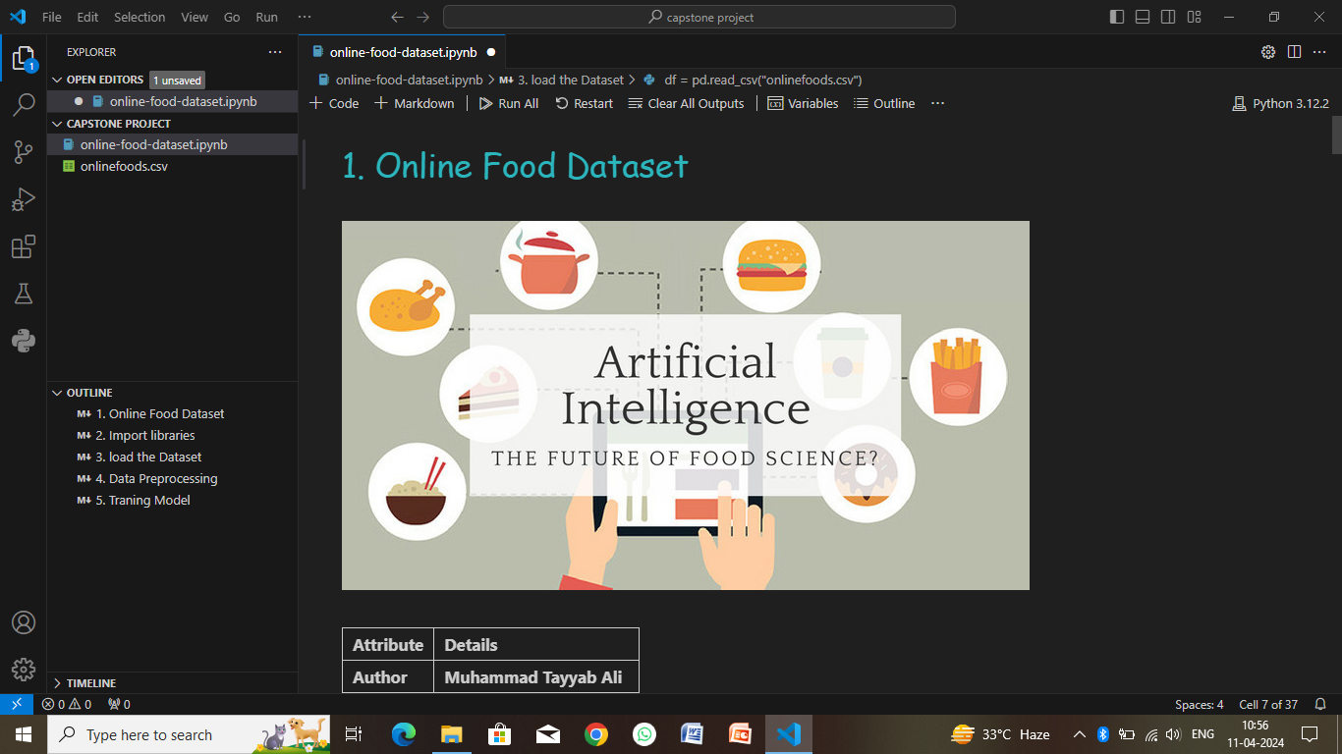
Result

Slide 9
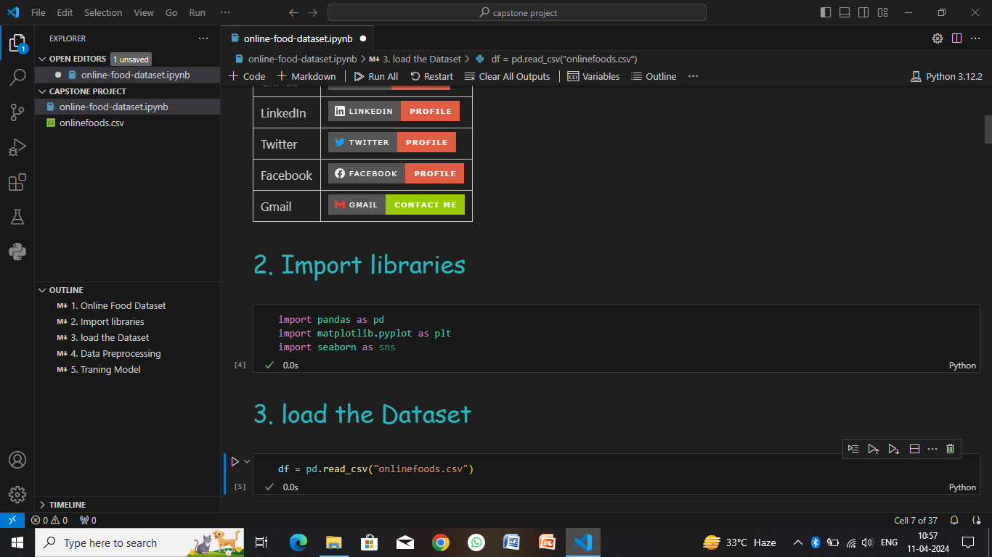

Slide 10
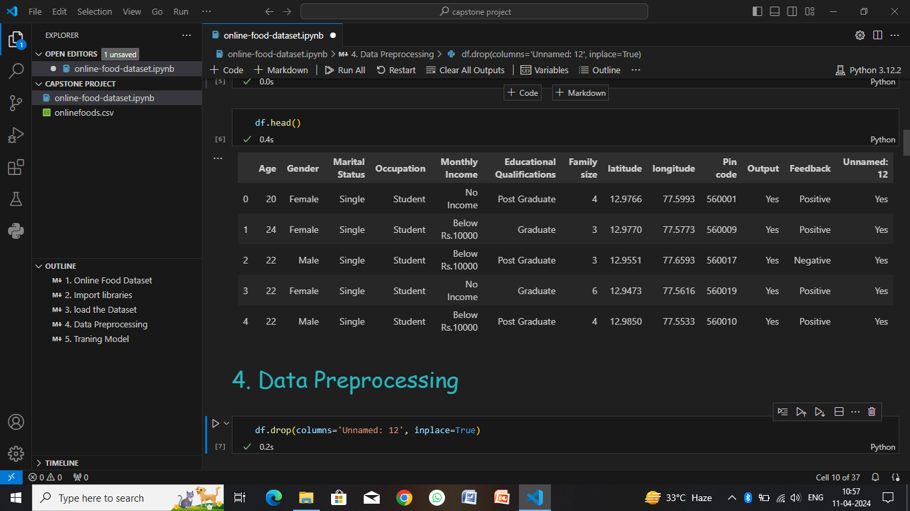

Slide 11
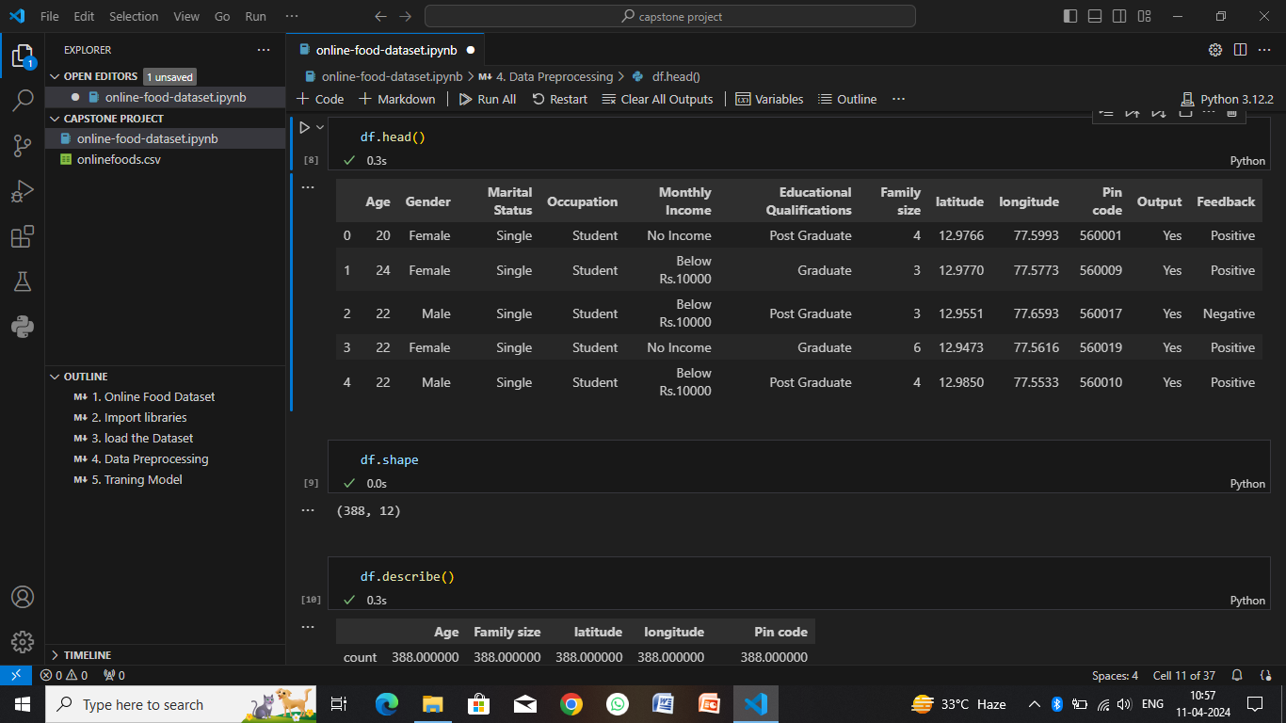

Slide 12
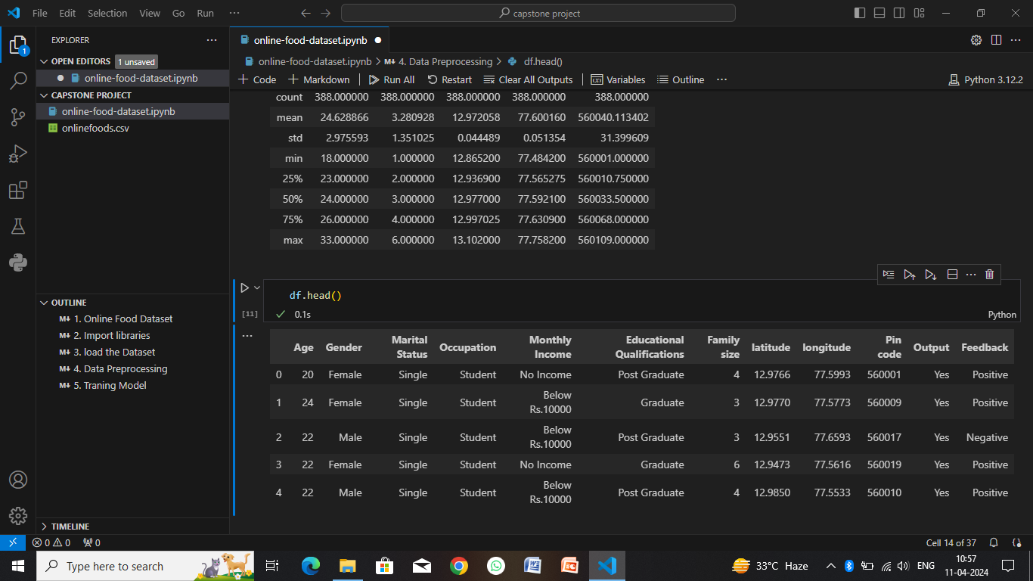

Slide 13
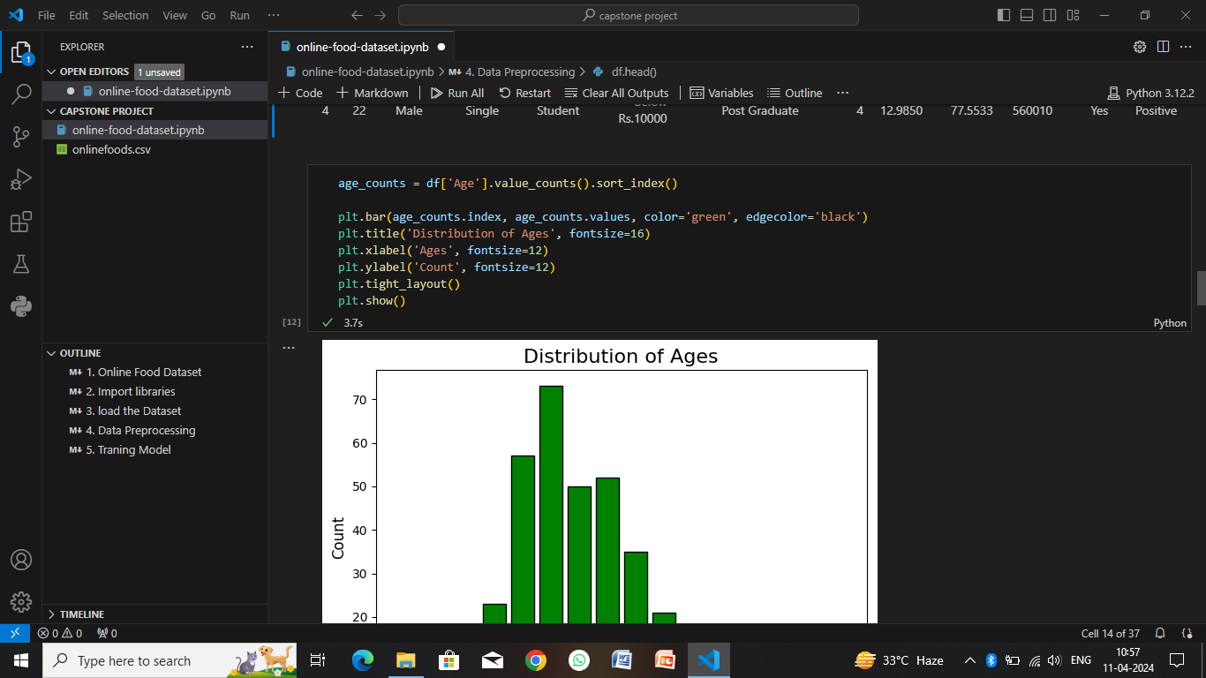

Slide 14
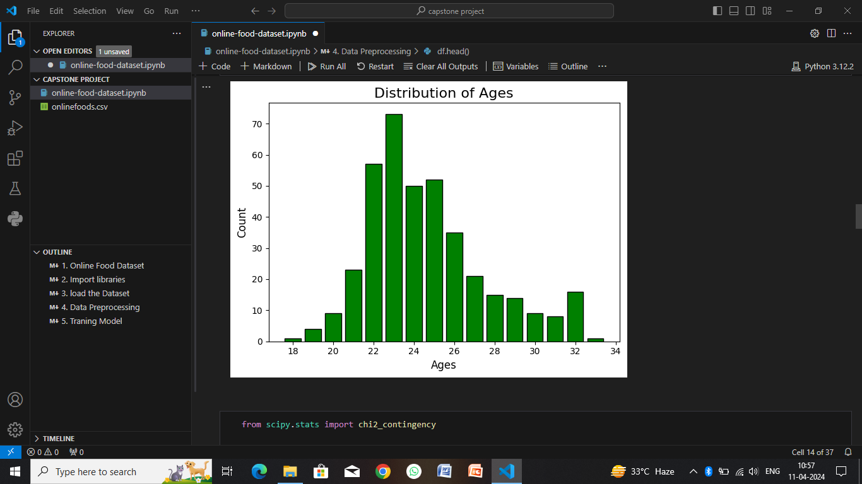

Slide 15
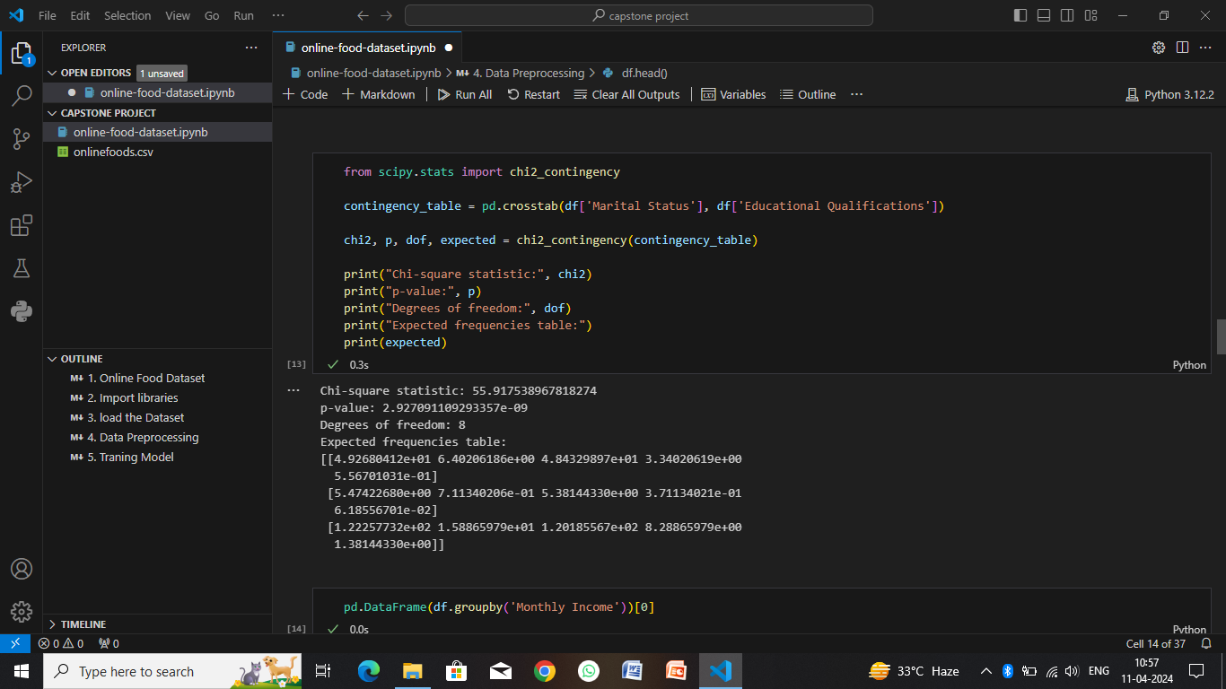

Slide 16
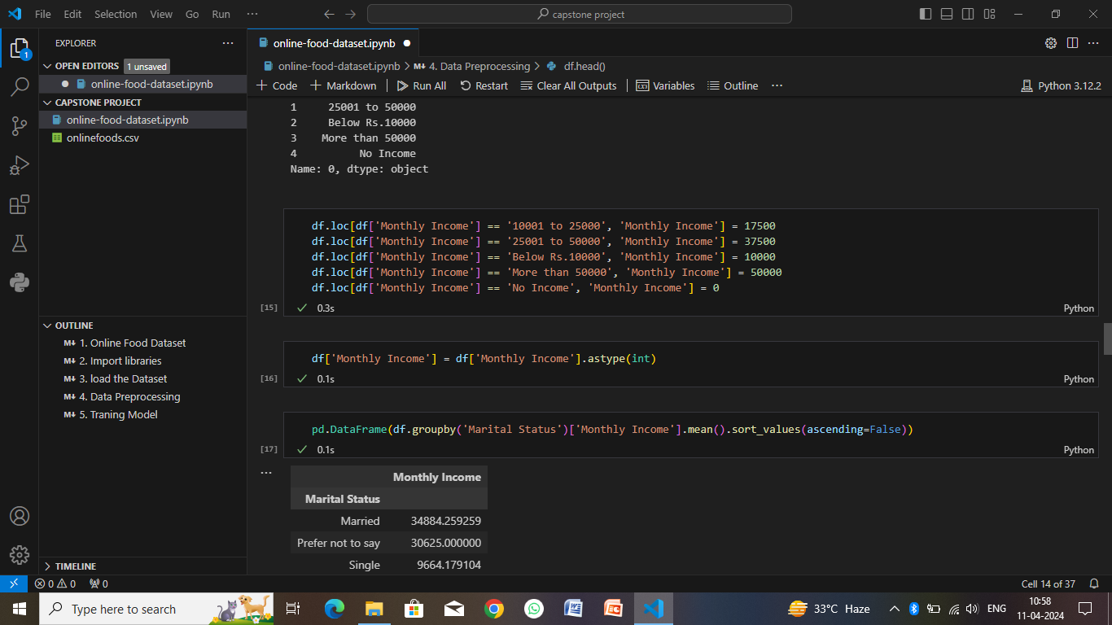

Slide 17
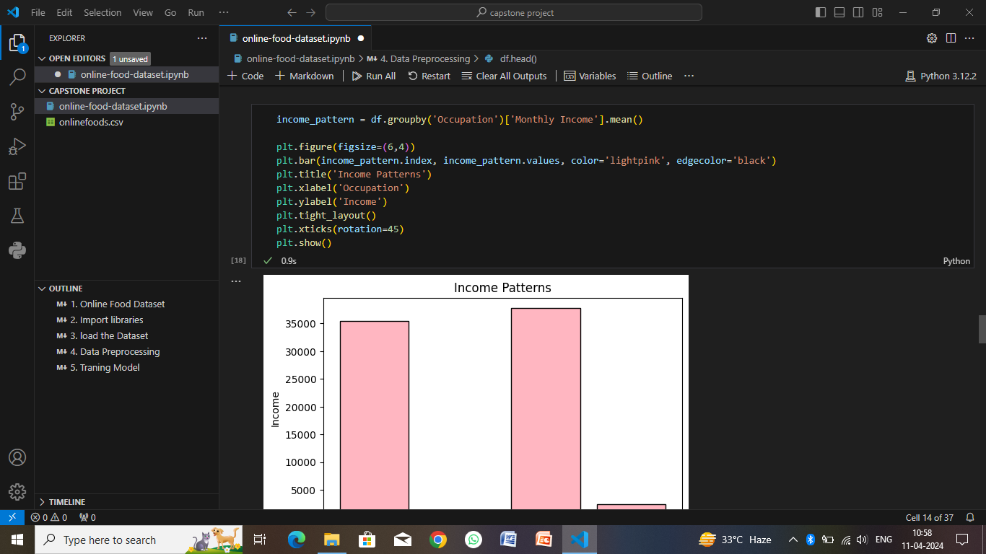

Slide 18
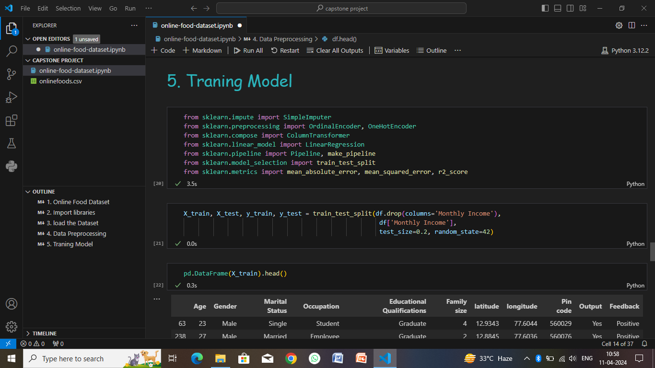

Slide 19
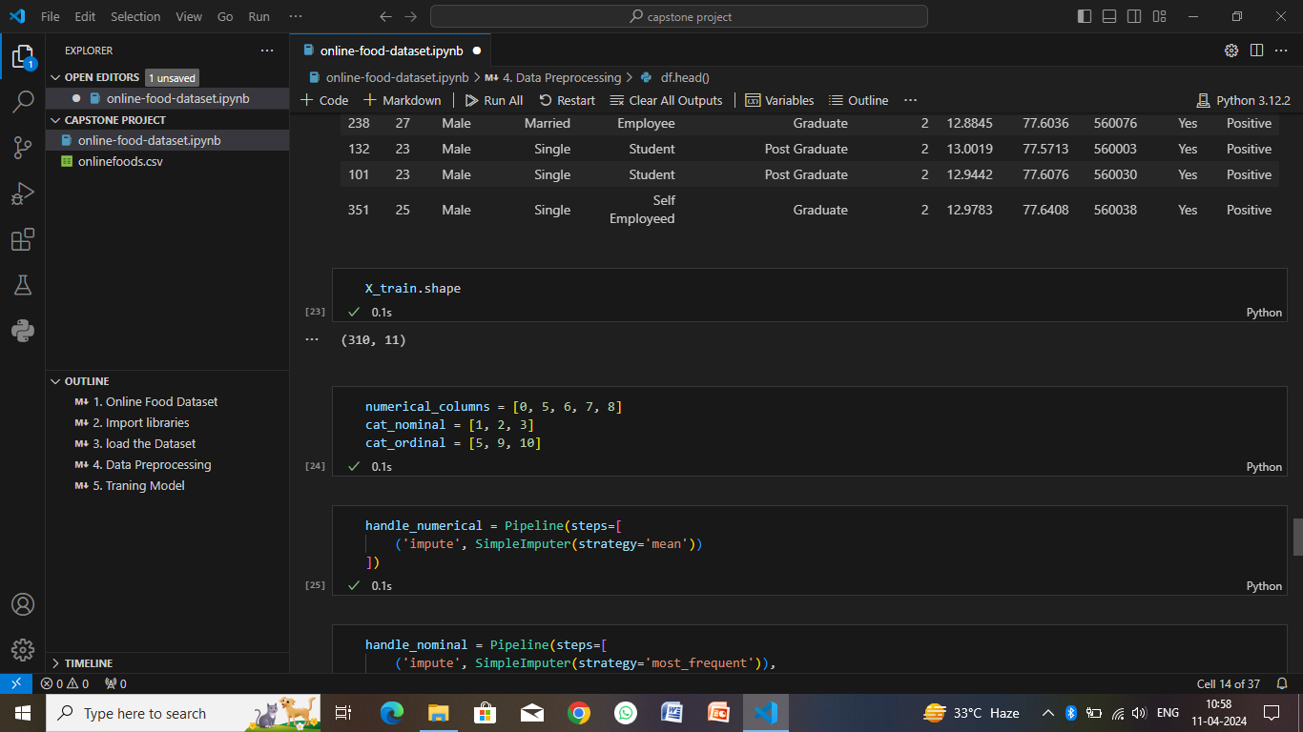

Slide 20
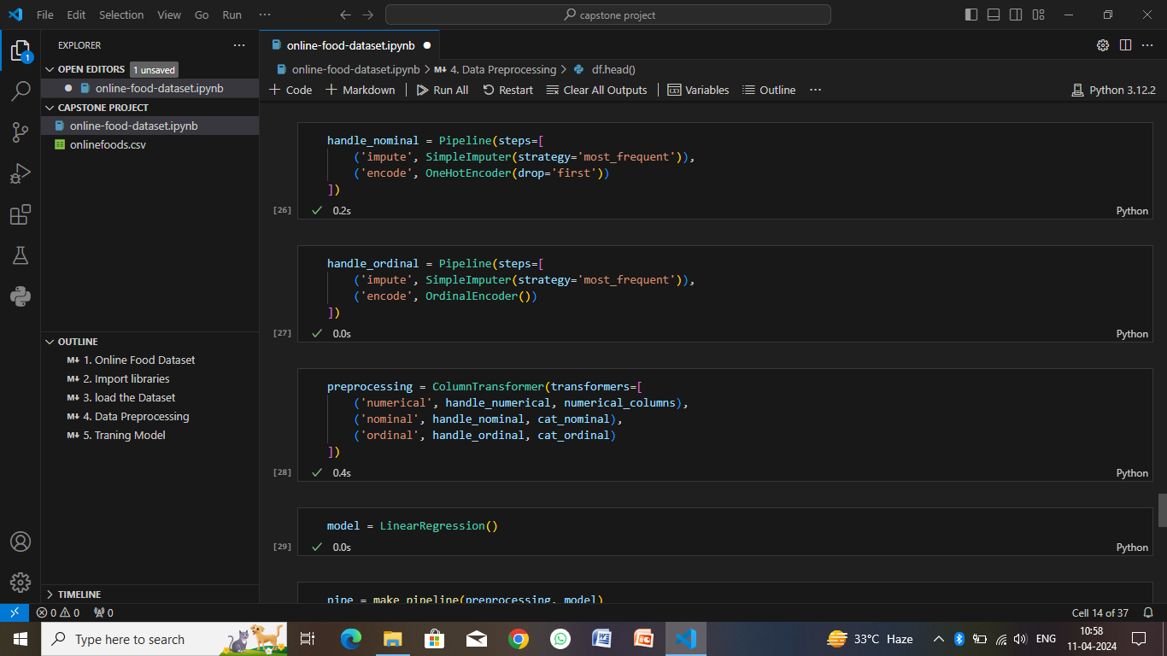

Slide 21
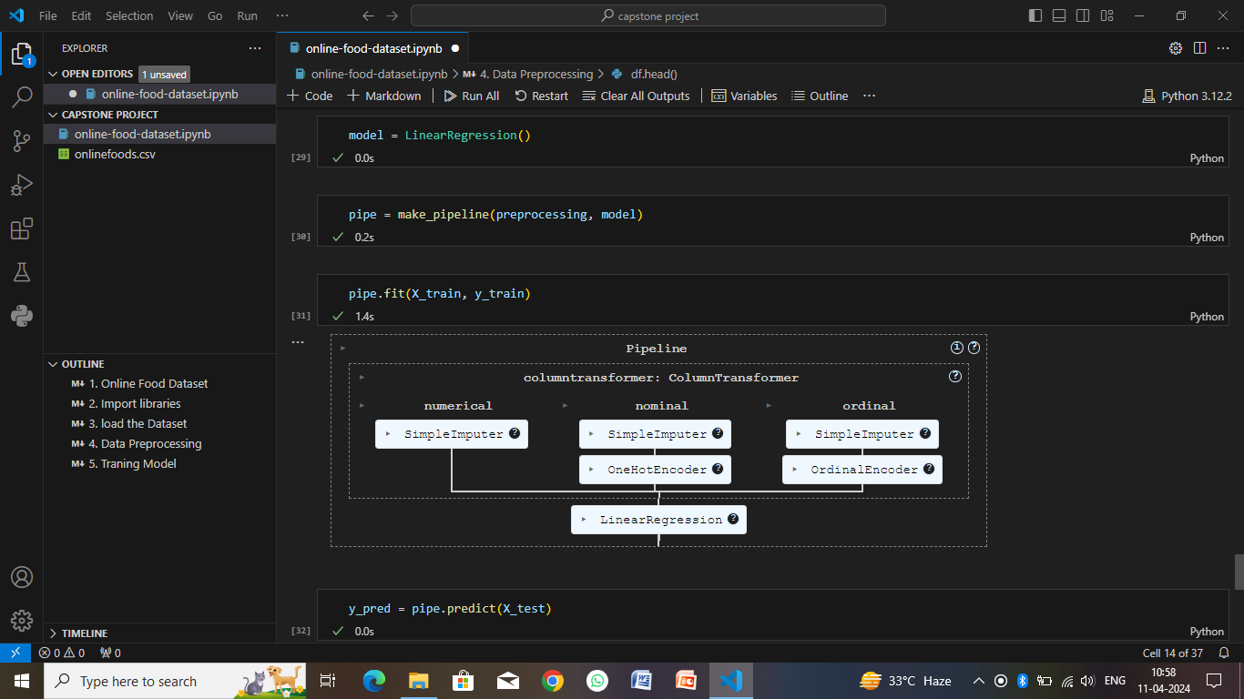

Slide 22
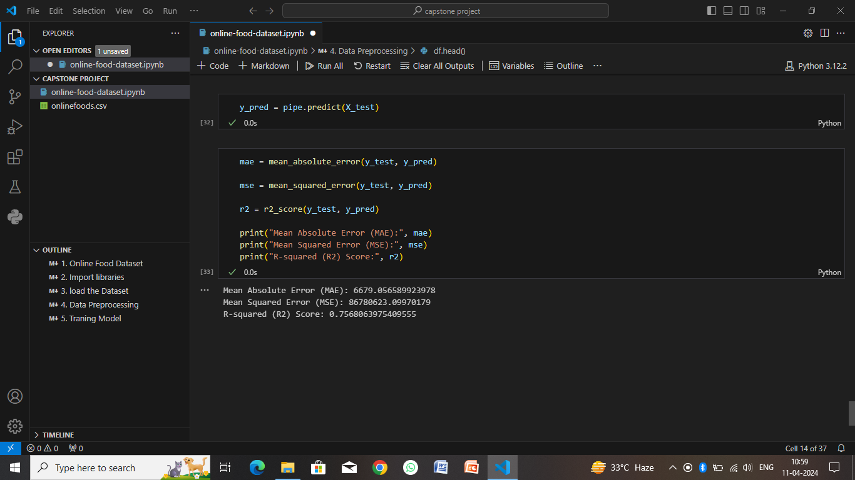

Slide 23
Conclusion
The online food industry presents a dynamic and competitive landscape with numerous opportunities and challenges. Through a systematic approach that encompasses market analysis, competitor evaluation, customer segmentation, technology assessment, operational optimization, regulatory compliance, financial planning, and strategic deployment of algorithms, businesses in this sector can navigate complexities effectively and drive success.
Key take a ways from this approach include:
Market Understanding
Competitive Insights
Customer-Centric Approach
Technology Integration
Operational Excellence
Regulatory Compliance
Financial Strategy
Continuous Improvement

Slide 24
Future scope
Technology Integration: Continued advancements in technology, such as AI, machine learning, blockchain, IoT (Internet of Things), and augmented reality, will revolutionize the online food industry. AI-driven personalization, predictive analytics for demand forecasting, smart kitchen appliances, and blockchain-based supply chain traceability will enhance efficiency, transparency, and customer experiences.
Delivery Innovations: The future of food delivery will witness innovations in delivery methods, including drones, autonomous vehicles, and robotic delivery systems. These technologies will enable faster, more reliable, and cost-effective delivery options, especially in urban areas with high demand for quick deliveries.
Sustainability Initiatives: With increasing awareness of environmental sustainability, the online food industry will focus on eco-friendly practices. This includes sustainable packaging solutions, locally sourced ingredients, reduced food waste, energy-efficient operations, and carbon footprint reduction strategies.
Health and Wellness: The trend towards healthier eating habits will continue to influence the online food sector. More emphasis will be placed on offering nutritious menu options, allergen-free choices, dietary preferences (e.g., vegan, gluten-free), and transparent nutritional information to cater to health-conscious consumers.
Partnerships and Ecosystem Integration: Collaborations between food tech companies, logistics providers, payment gateways, and other stakeholders will create integrated ecosystems. Partnerships with local producers, farmers, restaurants, and community initiatives will foster sustainability, support local economies, and enhance value propositions for customers.

Slide 25
References
Market Research Reports:
Statista: https://www.statista.com/
MarketResearch.com: https://www.marketresearch.com/
Euromonitor International: https://www.euromonitor.com/
Industry Publications:
Food Dive: https://www.fooddive.com/
Restaurant Business: https://www.restaurantbusinessonline.com/
QSR Magazine: https://www.qsrmagazine.com/
The Spoon: https://thespoon.tech/
Government Databases and Reports:
U.S. Food and Drug Administration (FDA): https://www.fda.gov/
Department of Agriculture (USDA): https://www.usda.gov/
European Food Safety Authority (EFSA): https://www.efsa.europa.eu/

Slide 26
THANK YOU

